Slide 1

HMT ANSYS PROJECT
Topic: Heat flow through the composite pipe.

Slide 2
Presented to:-
Dr. Neeraj Sharma sir.
Done by:-
V . Sahith Reddy
G . Dheeraj
G. Venkata Sai Jai Harsha
Timothy Philp.

Slide 3
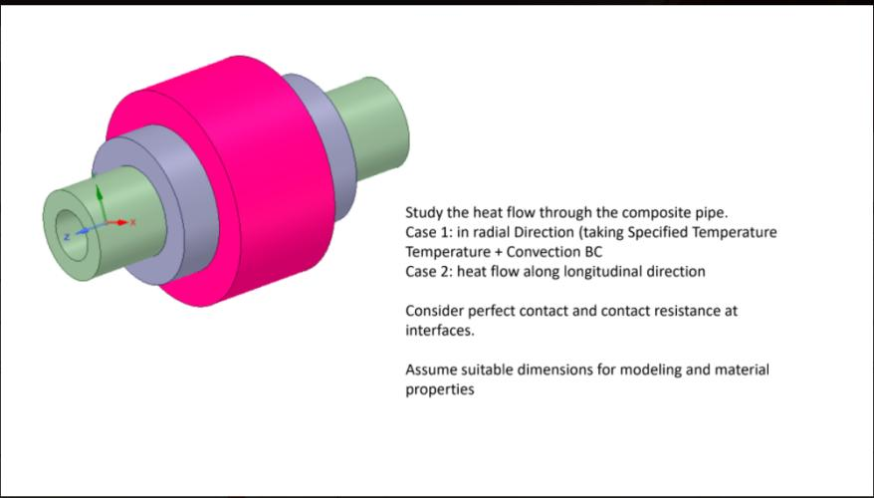

Slide 4
CASES TO BE SIMULATED
Case 1
Heat flow in radial Direction Temperature and convection.
Case 2
Heat flow along longitudinal direction.
Dimensions
Radius 1 = 4m Height 1 = 24m
Radius 2 = 7m Height 2 = 14m
Radius 3 = 9m Height 3 =8m
Radius 4 =13m
Materials used
1 Structural steel
2 Aluminum alloy
3 copper alloy
4 Titanium

Slide 5
Cases to be simulated-Student Wise
Jai Harsha
Materials
1 Inner material – structural steel
2 copper
3 Aluminum
Case 1 (In radial Direction Temperature and convection.)
Temperature = 70-degree c- 1 ,convection film coefficient =10 w/m^2 -3 –free convection.
Temperature = 70-degree c- 1 , convection film coefficient =100 w/m^2 -3 – forced convection.
Temperature = 120-degree c- 1 , Temperature = 80-degree c- 3
convection film coefficient =15 w/m^2 -1, Temperature = 90-degree c- 2, convection film coefficient =90 w/m^2 -3.
Case 2 (Heat flow along longitudinal direction.)
Temperature = 250-degree c- 1-front, convection film coefficient =10 w/m^2 -2 back.
Temperature = 250-degree c- 1 front , Temperature = 130-degree c- 3 back.
Temperature = 100-degree c- 2-front, convection film coefficient =100 w/m^2 -3 back.
Temperature = 250-degree c- 1 front, Temperature = 80-degree c- 3 back, convection film coefficient =15 w/m^2 -2 front.
Contact resistance 1-2 = 20,000 w/m^2 , Contact resistance 2-3 = 15,000w/m^2.

Slide 6
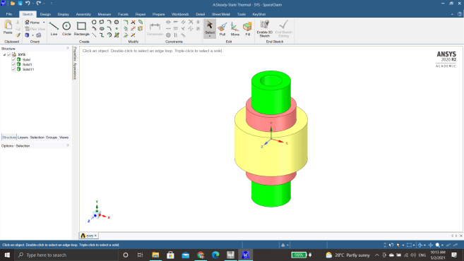
Modelling
Jai Harsha

Slide 7
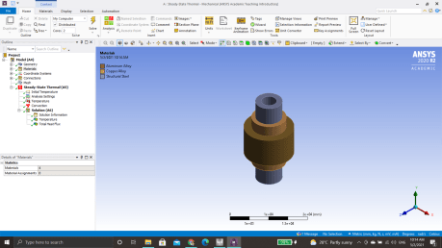
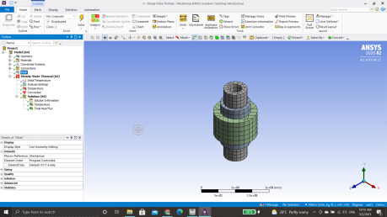
Material , Mesh
Materials-
1 Inner material – structural steel
2 copper
3 Aluminum
Mesh

Slide 8
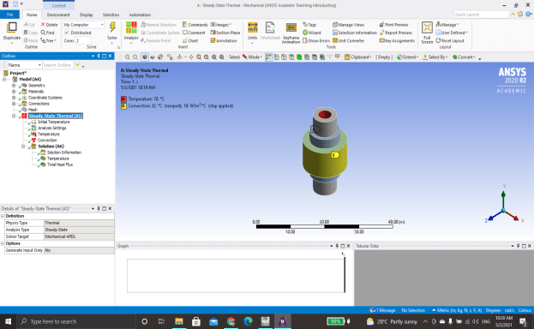
Case 1 (In radial Direction Temperature and convection.)
Boundary Conditions.
A
Temperature = 70-degree c- 1 convection film coefficient =10 w/m^2 -3 –free convection.
Jai Harsha

Slide 9
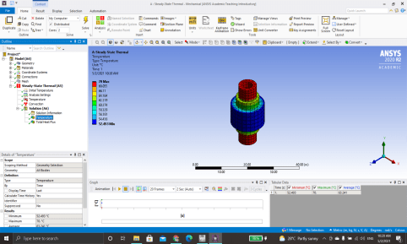
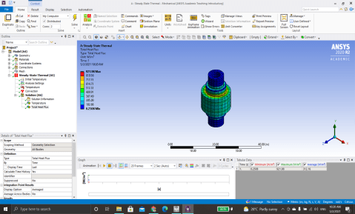
A- Solution
Maximum temperature =70-degree c
Minimum temperature = 52.493-degree c
Heat flux maximum = 921.98 w/m^2, minimum = 0.2508 w/m^2
Jai Harsha

Slide 10
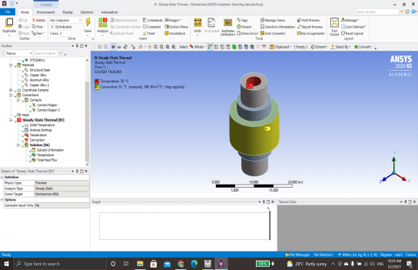
Case 1 (In radial Direction Temperature and convection.) Boundary Conditions. B Temperature = 70-degree c- 1 , convection film coefficient =100 w/m^2 -3 – forced convection.
Jai Harsha

Slide 11
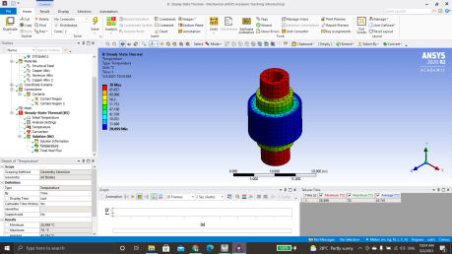
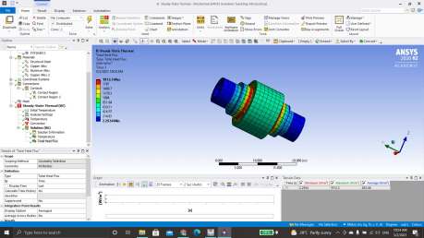
B- Solution
Maximum temperature =70-degree c
Minimum temperature = 28.899-degree c
Heat flux maximum = 1913.3 w/m^2, minimum = 2.2934 w/m^2
Jai Harsha

Slide 12
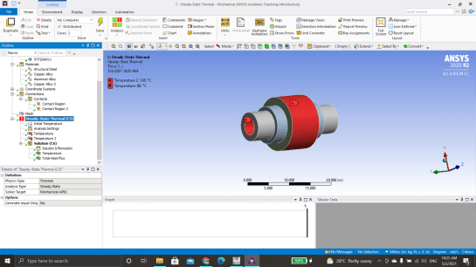
Case 1 (In radial Direction Temperature and convection.) Boundary Conditions. C Temperature = 120-degree c- 1 , Temperature = 80-degree c- 3
Jai Harsha

Slide 13
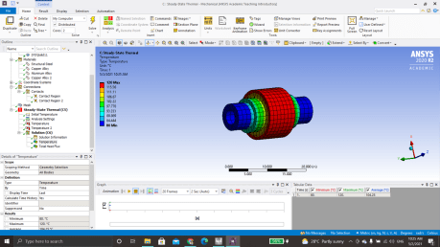
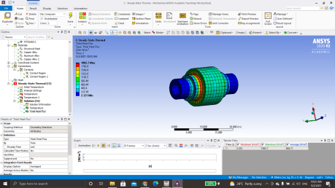
C- Solution
Maximum temperature =120-degree c
Minimum temperature = 80-degree c
Heat flux maximum = 1982.7 w/m^2, minimum = 2.325 w/m^2
Jai Harsha

Slide 14
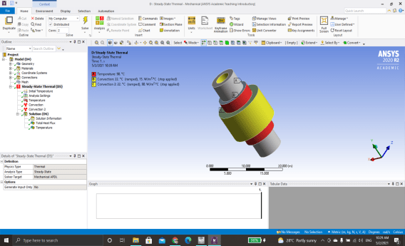
Case 1 (In radial Direction Temperature and convection.) Boundary Conditions. D convection film coefficient =15 w/m^2 -1, Temperature = 90-degree c- 2, convection film coefficient =90 w/m^2 -3.
Jai Harsha

Slide 15
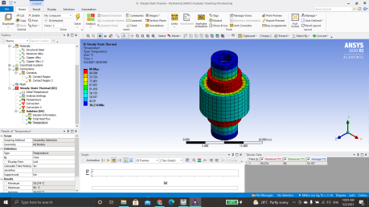
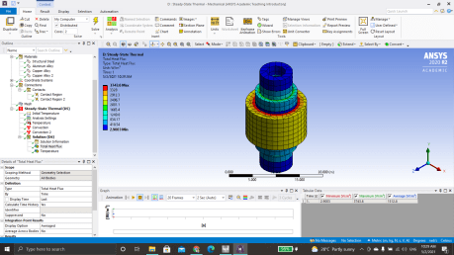
D- Solution
Maximum temperature =90-degree c
Minimum temperature = 39.274-degree c
Heat flux maximum = 3743.6 w/m^2, minimum = 2.9003 w/m^2
Jai Harsha

Slide 16
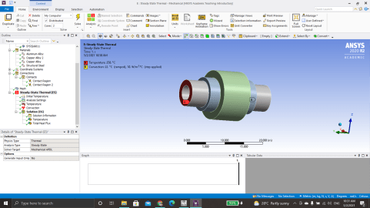
Case 2 (Heat flow along longitudinal direction.) Boundary Conditions. A Temperature = 250-degree c- 1-front, convection film coefficient =10 w/m^2 -2 back.
Jai Harsha

Slide 17
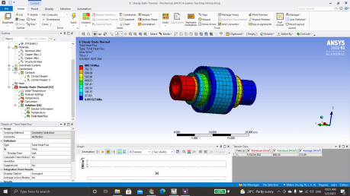
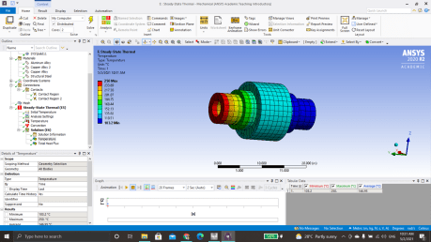
A- Solution
Maximum temperature = 250 -degree c
Minimum temperature =103.2 -degree c
Heat flux maximum = 880.54 w/m^2, minimum = 0.095525 w/m^2
Jai Harsha

Slide 18
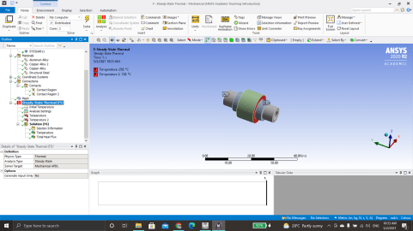
Case 2 (Heat flow along longitudinal direction.) Boundary Conditions. B Temperature = 250-degree c- 1 front , Temperature = 130-degree c- 3 back.
Jai Harsha

Slide 19
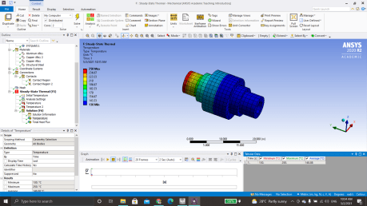
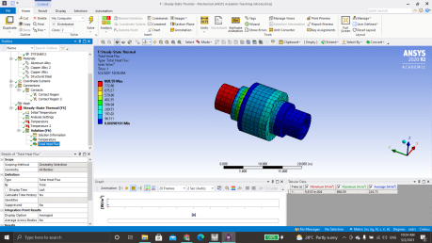
B- Solution
Maximum temperature =250degree c
Minimum temperature = 130-degree c
Heat flux maximum = 868.59 w/m^2, minimum = 0.00098101 w/m^2
Jai Harsha

Slide 20
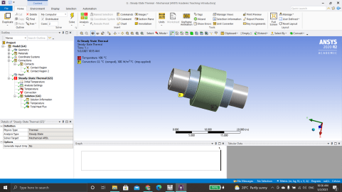
Case 2 (Heat flow along longitudinal direction.) Boundary Conditions. C Temperature = 100-degree c- 2-front, convection film coefficient =100 w/m^2 -3 back.
Jai Harsha

Slide 21
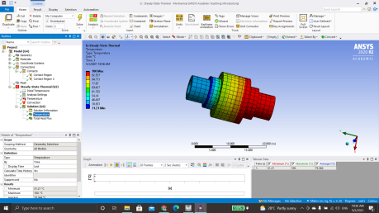
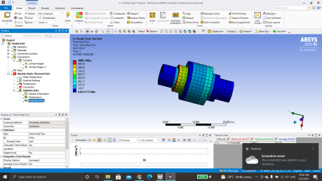
C- Solution
Maximum temperature =100degree c
Minimum temperature = 31.21-degree c
Heat flux maximum = 1086.3 w/m^2, minimum = 0.0011772 w/m^2
Jai Harsha

Slide 22
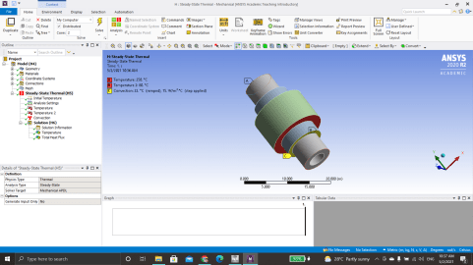
Case 2 (Heat flow along longitudinal direction.) Boundary Conditions. D Temperature = 250-degree c- 1 front, Temperature = 80-degree c- 3 back, convection film coefficient =15 w/m^2 -2 front.
Jai Harsha

Slide 23
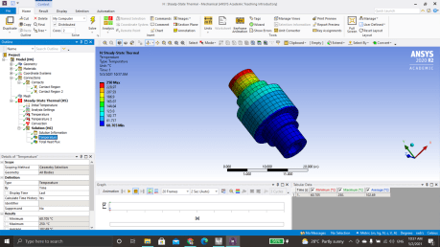
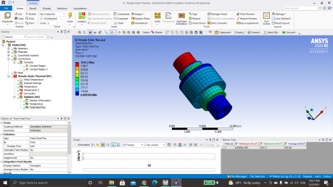
D- Solution
Maximum temperature =250degree c
Minimum temperature = 60.705-degree c
Heat flux maximum = 1247.2 w/m^2, minimum = 0.068506 w/m^2
Jai Harsha

Slide 24
G. Dheeraj

Slide 25
Cases to be simulated
Materials
1 Inner material – copper
2 Aluminum
3 stainless steel
Case 1 (In radial Direction Temperature and convection.)
Temperature = 80-degree c- 1 ,convection film coefficient =10 w/m^2 -3 –free convection.
Temperature = 80-degree c- 1 , convection film coefficient =105 w/m^2 -3 – forced convection.
Convection film coefficient = 10 w/m^2 -1, convection film coefficient = 95 w/m^2 -3
convection film coefficient =10 w/m^2 -1, Temperature = 85-degree c- 2, , Temperature = 50-degree c- 3.
Case 2 (Heat flow along longitudinal direction.)
Temperature = 300-degree c- 1-front, convection film coefficient =15 w/m^2 -2 back.
Temperature = 300-degree c- 1 front , Temperature = 160-degree c- 2 back.
Temperature = 300-degree c- 1-front, convection film coefficient =110 w/m^2 -2 back.
Temperature = 300-degree c- 1 front, Temperature = 130-degree c- 1 back, convection film coefficient =13 w/m^2 -2 front.
Contact resistance 1-2 = 56,000 w/m^2 , Contact resistance 2-3 = 3,600w/m^2.

Slide 26
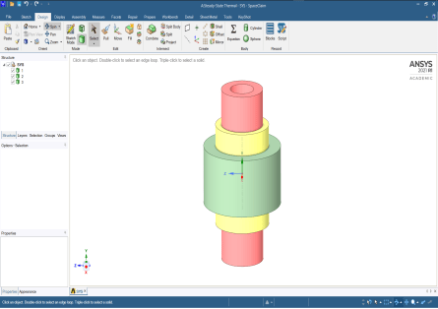
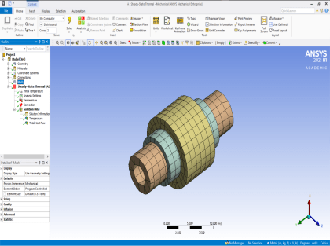
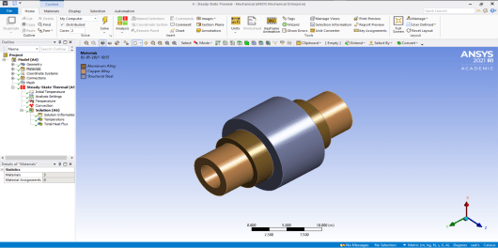
Materials-
1 Inner material – copper
2 aluminum alloy
3 stainless steel
Modeling
Meshing

Slide 27
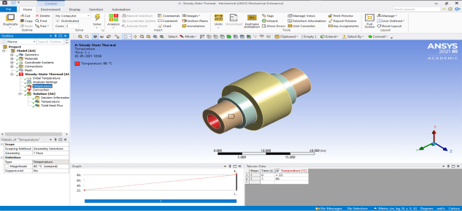
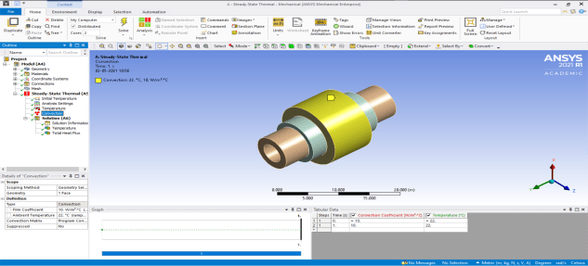
Case 1 (In radial Direction Temperature and convection.)
Boundary Conditions.
A . Temperature = 80-degree c- 1 ,convection film coefficient =10 w/m^2 -3 –free convection.

Slide 28
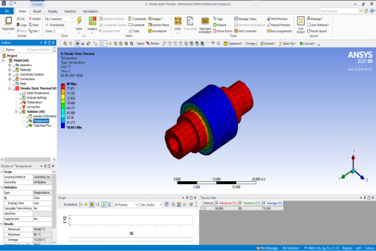
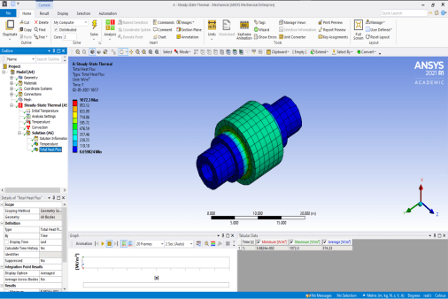
A- Solution
Maximum temperature =80-degree c
Minimum temperature = 58.8633-degree c
Heat flux maximum = 1072.3, minimum = 0.059824

Slide 29
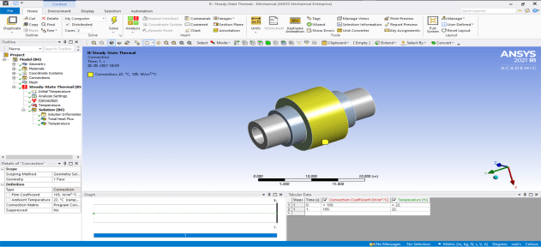
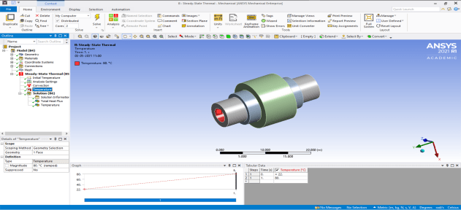
Case 1 (In radial Direction Temperature and convection.) Boundary Conditions. B . Temperature = 80-degree c- 1 , convection film coefficient =105 w/m^2 -3 – forced convection.

Slide 30
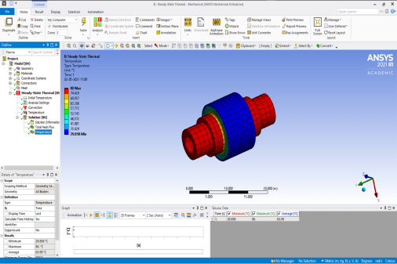
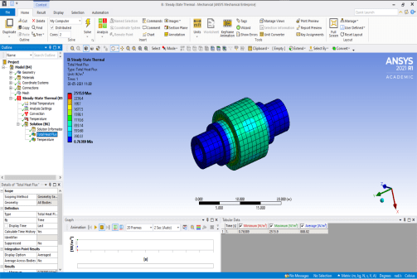
B- Solution
Maximum temperature =80-degree c
Minimum temperature = 29.858-degree c
Heat flux maximum = 2515.9, minimum = 0.76389

Slide 31
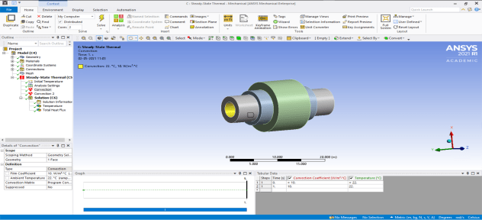
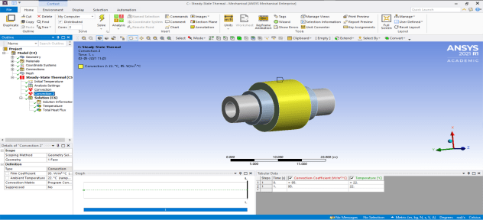
Case 1 (In radial Direction Temperature and convection.) Boundary Conditions. C. Convection film coefficient = 10 w/m^2 -1, convection film coefficient = 95 w/m^2 -3

Slide 32
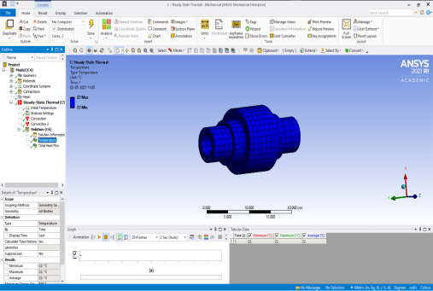
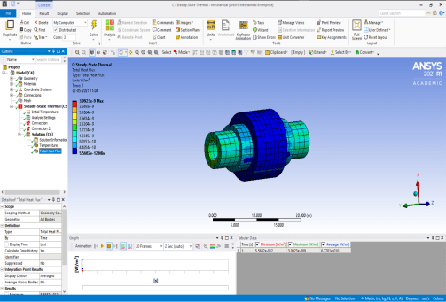
C- Solution
Maximum temperature =22 degree c
Minimum temperature = 22 degree c
Heat flux max = 3.992e-9w/m^2 , min = 5.5682e-12w/m^2

Slide 33
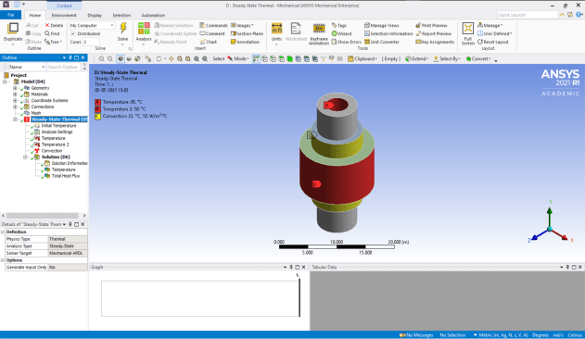
Case 1 (In radial Direction Temperature and convection.) Boundary Conditions. D. convection film coefficient =10 w/m^2 -1, Temperature = 85-degree c- 2, , Temperature = 50-degree c- 3.

Slide 34
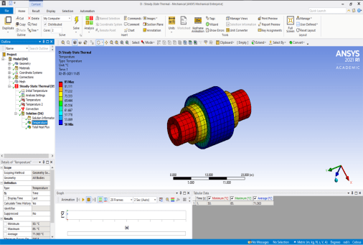
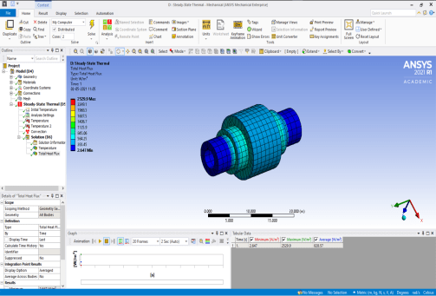
D- Solution
Maximum temperature =85 degree c
Minimum temperature = 50 degree c
Heat flux maximum = 2529.9w/m^2, min = 2.647w/m^2

Slide 35
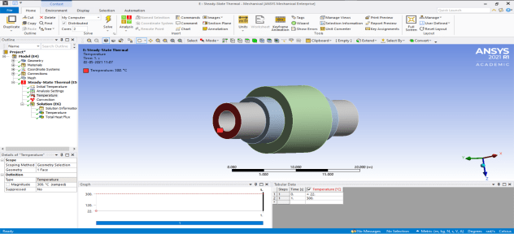
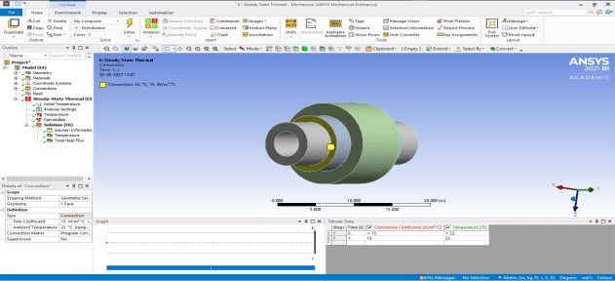
Case 2 (Heat flow along longitudinal direction.) Boundary Conditions. A. 300-degree c- 1-front, convection film coefficient =15 w/m^2 -2 back.

Slide 36
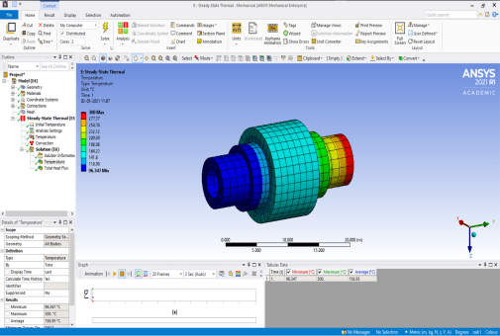
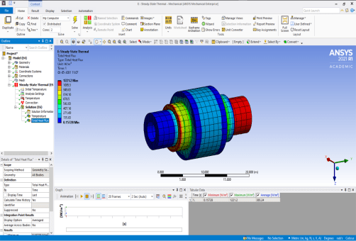
A- Solution
Maximum temperature =300 degree c
Minimum temperature = 96.347 degree c
Heat flux maximum = 1221.2w/m^2, min = 0.15728w/m^2

Slide 37


Case 2 (Heat flow along longitudinal direction.) Boundary Conditions. B. Temperature = 300-degree c- 1 front , Temperature = 160-degree c- 2 back.

Slide 38


B- Solution
Maximum temperature =300 degree c
Minimum temperature = 160 degree c
Heat flux maximum = 4138.6w/m^2 , min = 0.54201w/m^2

Slide 39


Case 2 (Heat flow along longitudinal direction.) Boundary Conditions. C. Temperature = 300-degree c- 1-front, convection film coefficient =110 w/m^2 -2 back.

Slide 40


C- Solution
Maximum temperature =300 degree c
Minimum temperature = 39.795 degree c
Heat flux maximum = 8452.6w/m^2, min = 1.1674w/m^2

Slide 41

Case 2 (Heat flow along longitudinal direction.) Boundary Conditions. D. Temperature = 300-degree c- 1 front, Temperature = 130-degree c- 1 back, convection film coefficient =13 w/m^2 -2 front.

Slide 42


D- Solution
Maximum temperature =300 degree c
Minimum temperature = 130 degree c
Heat flux maximum = 4968.4w/m^2, min = 0.068506w/m^2

Slide 43
Cases to be simulated
V .SAHITH REDDY -190228
Materials
1 Inner material -Titanium
2 middle – structural steel
3 Outer- copper
Case 1 (In radial Direction Temperature and convection.)
Temperature = 90-degree c- 1 ,convection film coefficient =5 w/m^2 -3 –Normal convection.
Temperature = 90-degree c- 1 , convection film coefficient =95 w/m^2 -3 – forced convection.
Temperature = 120-degree c- 1 , Temperature = 70-degree c- 3
convection film coefficient =12 w/m^2 -1, Temperature = 1000-degree c- 2, convection film coefficient =95 w/m^2 -3.
Case 2 (Heat flow along longitudinal direction.)
Temperature = 200-degree c- 1, convection film coefficient =11 w/m^2 -2.
Temperature = 200-degree c- 1, Temperature = 120-degree c- 3.
Temperature = 200-degree c- 2, convection film coefficient =80 w/m^2 -3.
Temperature = 200-degree c- 1, Temperature = 80-degree c- 3, convection film coefficient =11 w/m^2 -2
Contact resistance 1-2 = 15000 w/m^2 , Contact resistance 2-3 = 12,000w/m^2.

Slide 44

GEOMETRY:

Slide 45

MATERIALS ASSIGNED

Slide 46

MESH

Slide 47

Case 1 (In radial Direction Temperature and convection.)
Boundary Conditions.
A. Temperature = 90-degree c-, convection film coefficient =5 w/m^2 –Normal convection.
SAHITH REDDY-190228

Slide 48


A- Solution
Maximum temperature =90-degree c
Minimum temperature = 62.582-degree c
Heat flux maximum =1198.1 max, minimum =0.4917 min

Slide 49

Case 1 (In radial Direction Temperature and convection.) Boundary Conditions. B. Temperature = 90-degree c, convection film coefficient =95 w/m^2 – forced convection
SAHITH REDDY-190228

Slide 50


B- Solution
Maximum temperature =90-degree c
Minimum temperature = 26.657-degree c
Heat flux maximum = 2775.8max, minimum =1.1387 min

Slide 51

Case 1 (In radial Direction Temperature and convection.) Boundary Conditions. C. Temperature = 120-degree , Temperature = 70-degree
SAHITH REDDY-190228

Slide 52


C- Solution
Maximum temperature =120-degree c
Minimum temperature = 70-degree c
Heat flux maximum = 2126max, minimum = 0.90163min

Slide 53

Case 1 (In radial Direction Temperature and convection.) Boundary Conditions. D. convection film coefficient =12 w/m^2 , Temperature = 100-degree c, convection film coefficient =95 w/m^2.
SAHITH REDDY-190228

Slide 54


D- Solution
Maximum temperature =100-degree c
Minimum temperature = 29.651-degree c
Heat flux maximum = 6822.3max, minimum = 1.0099min

Slide 55


Case 2 (Heat flow along longitudinal direction.) Boundary Conditions. A. Temperature = 200-degree c, convection film coefficient =11 w/m^2.

Slide 56


A- Solution
Maximum temperature =200degree c
Minimum temperature = 59.485-degree c
Heat flux maximum = 693.82 minimum = 103.2

Slide 57

Case 2 (Heat flow along longitudinal direction.) Boundary Conditions. B. Temperature = 200-degree c , Temperature = 120-degree c.

Slide 58


B- Solution
Maximum temperature =200degree c
Minimum temperature = 120-degree c
Heat flux maximum = 448.14max, minimum = 3.3415e-5min

Slide 59

Case 2 (Heat flow along longitudinal direction.) Boundary Conditions. C. Temperature = 200-degree c, convection film coefficient =80 w/m^2
a

Slide 60


C- Solution
Maximum temperature =200degree c
Minimum temperature = 28.195-degree c
Heat flux maximum = 852.81max, minimum = 0.04010min

Slide 61

Case 2 (Heat flow along longitudinal direction.) Boundary Conditions. D. convection fil 11w/m^2, Temperature 200C Forced convection 80w/m^2

Slide 62


D- Solution
Maximum temperature =200degree c
Minimum temperature = 24.344-degree c
Heat flux maximum = 936.2max, minimum = 0.0146min

Slide 63
Cases to be simulated
Timothy Philip
Materials
1 Inner material – Aluminum
2 structural steel
3 copper
Case 1 (In radial Direction Temperature and convection.)
Temperature = 75-degree c- 1 ,convection film coefficient =8 w/m^2 -3 –free convection.
Temperature = 75-degree c- 1 , convection film coefficient =110 w/m^2 -3 – forced convection.
convection film coefficient = 5-w/m^2 -1 –convection., convection = 100- w/m^2 -3 – forced convection
convection film coefficient =5 w/m^2 -2, Temperature = 90-degree c- 1, Temperature = 40-degree c- 3
Case 2 (Heat flow along longitudinal direction.)
Temperature = 400-degree c- 1-front, convection film coefficient =10w/m^2 -2 back.
Temperature = 400-degree c- 2 front , Temperature = 250-degree c- 2 back.
Temperature = 400-degree c- 2-front, convection film coefficient =90 w/m^2 -2 back.
Temperature = 400-degree c- 2 front, convection film coefficient =90 w/m^2 -1 back, convection film coefficient =13 w/m^2 -1 front.
Contact resistance 1-2 = 18,000 w/m^2 , Contact resistance 2-3 = 40,000w/m^2.

Slide 64



Materials-
1 Inner material – structural steel
2 copper
3 Aluminum
Modelling
Meshing
Timothy Philip
Timothy Philip

Slide 65

Case 1 (In radial Direction Temperature and convection.)
Boundary Conditions.
A
Temperature = 75-degree c- 1 ,
convection film coefficient =8 w/m^2 -3 – convection.
Timothy Philip

Slide 66


A- Solution
Maximum temperature =75-degree c
Minimum temperature = 60.369-degree c
Heat flux maximum = 999.69max, minimum = 0.0482min
Timothy Philip

Slide 67

Case 1 (In radial Direction Temperature and convection.) Boundary Conditions. B 75-degree c- 1 , convection film coefficient =110 w/m^2 -3 – forced convection.
Timothy Philip

Slide 68


B- Solution
Maximum temperature =75-degree c
Minimum temperature = 30.289-degree c
Heat flux maximum = 4156.7max, minimum = 0.94061min

Slide 69

Case 1 (In radial Direction Temperature and convection.) Boundary Conditions. C convection film coefficient = 5-w/m^2 -1 –convection., convection = 100- w/m^2 -3 – forced convection
Timothy Philip

Slide 70


C- Solution
Maximum directional heat =2.8565e-9
Minimum directional heat =-2.4074e-9
Heat flux maximum = 4.2077e-9 max, minimum =-2.407e-9 min

Slide 71

Case 1 (In radial Direction Temperature and convection.) Boundary Conditions. D convection film coefficient =5 w/m^2 -2, Temperature = 90-degree c- 1, Temperature = 40-degree c- 3
Timothy Philip

Slide 72


D- Solution
Maximum temperature =90-degree c
Minimum temperature = 40-degree c
Heat flux maximum = 4132.2max, minimum = 1.9663min

Slide 73


Case 2 (Heat flow along longitudinal direction.) Boundary Conditions. A Temperature = 400-degree c- 1-front, convection film coefficient =10w/m^2 -2 back.
Timothy Philip

Slide 74


A- Solution
Maximum temperature =400 degree c
Minimum temperature = 231.4 degree c
Heat flux maximum = 2801.8max, minimum = 0.39923min

Slide 75


Case 2 (Heat flow along longitudinal direction.) Boundary Conditions. B Temperature = 400-degree c- 2 front , Temperature = 250-degree c- 2 back.
Timothy Philip

Slide 76


B- Solution
Maximum temperature =400 degree c
Minimum temperature = 250 degree c
Heat flux maximum = 3632.7max, minimum = 0.60217 min

Slide 77


Case 2 (Heat flow along longitudinal direction.) Boundary Conditions. C Temperature = 400-degree c- 2-front, convection film coefficient =90 w/m^2 -2 back.
Timothy Philip

Slide 78


C- Solution
Maximum temperature =400 degree c
Minimum temperature = 77.379 degree c
Heat flux maximum = 7730.4 max, minimum = 1.1465 min

Slide 79


Case 2 (Heat flow along longitudinal direction.) Boundary Conditions. D Temperature = 400-degree c- 2 front, convection film coefficient =90 w/m^2 -1 back, convection film coefficient =13 w/m^2 -1 front.
Timothy Philip

Slide 80


D- Solution
Maximum temperature =400 degree c
Minimum temperature = 68.352 degree c
Heat flux maximum = 8269.3 max, minimum = 12.755min

Slide 81

THANK YOU

